Slide 1

Restaurants and Cafe recommendation system
Abdulrahman Almegren

Slide 2





Table of contents
Introduction
Dataset
Data Cleaning
EDA
Recommender building
Simple app
Conclusion
References
Tools

Slide 3
Introduction
A restaurant is a business formation which prepares and serves food and drink to customers in return for money
Restaurants are essential sites where food, family, and friends interact, in favorite and good restaurants people can feel comfortable and rest and spend a lot of time enjoying a good restaurant.
Help users to make a choice.

Slide 4
Dataset
Dataset about Restaurants in Riyadh , Jeddah And Eastern Province
Kaggle
1830 rows
13 columns
Name : the name of the restaurant
type : type of food that it represents
location : the full location of the restaurant
review score : how many points did he get
review number: how many people give their feedback
City: where is the restaurant
opening hours : when he opens and when he close
price range: start from - until
Out of : his place out of the other restaurants represent the same type of food
Addressline1: extracted from location
address_line2:extracted from location
type 2 : extracted from type

Slide 5
Data Cleaning
Step 01
Step 02
Step 03
Check for NaN and deal with them.
Drop unwanted columns.
Check and drop duplicate.
Food type
Food type1
Out of
Phone
price range
1600 rows after cleaning

Slide 6
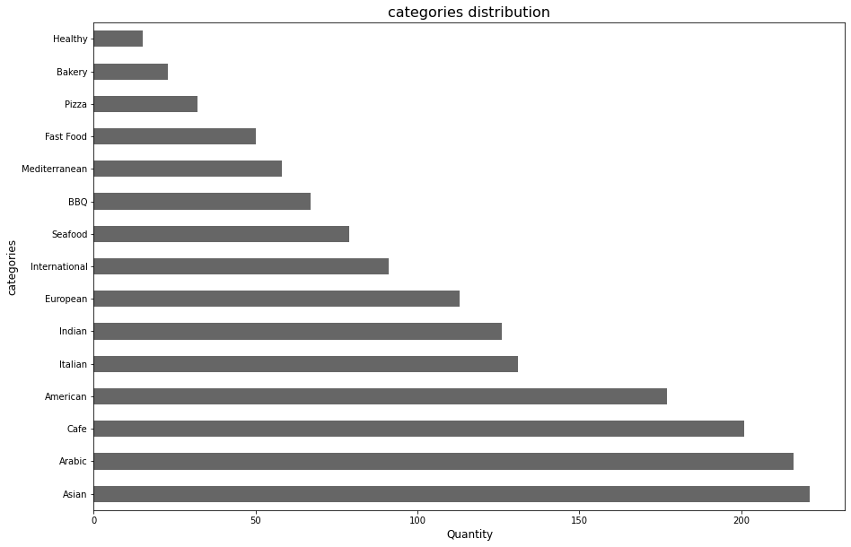
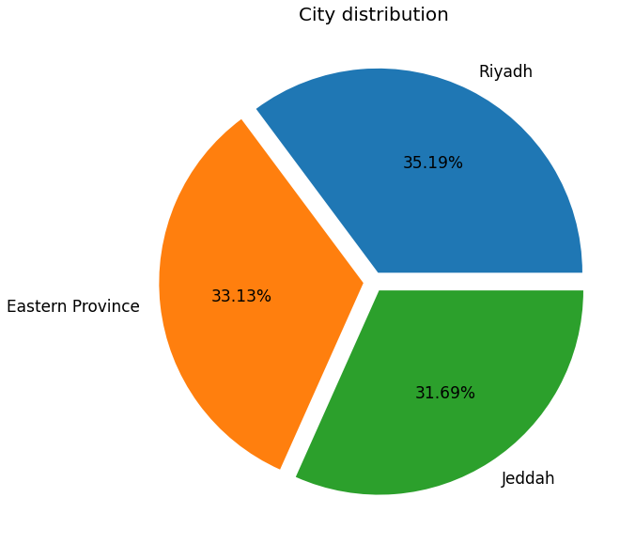
EDA - distribution

Slide 7
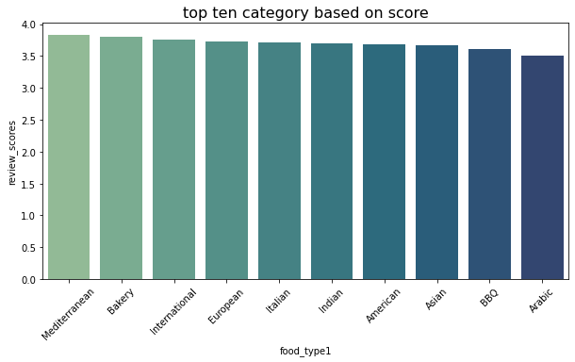
EDA - top category

Slide 8
Recommender building
Content Based Filtering:
tries to guess the features or behavior of a user given the item’s features, he/she reacts positively to.
Feature used : review score, out of, city, food type, food type1, location, number of reviews, opening hour
Cosine similarity is a metric used to measure how similar the documents are irrespective of their size
TF-IDF and count vectorizer.
Notes:
term frequency-inverse document frequency
both are methods for converting text data into vectors as model can process only numerical data.
CountVectorizer we only count the number of times a word appears in the document
TfidfVectorizer we consider overall document weightage of a word. It helps us in dealing with most frequent words. Using it we can penalize them. TfidfVectorizer weights the word counts by a measure of how often they appear in the documents

Slide 9
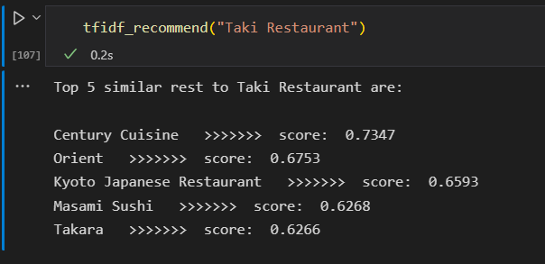
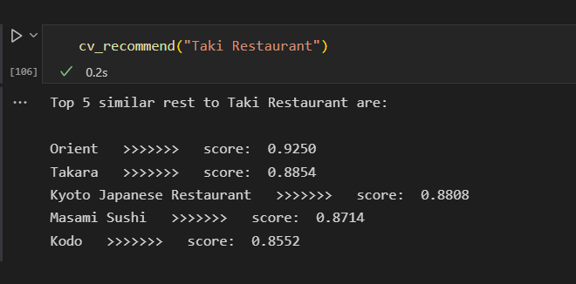
TF-IDF and Count Vectorizer

Slide 10
Conclusion, Challenges & Future work
TF-IDF are less in the score comparing to count vectorizer
The Dataset size is small, need to be updated
The dataset has a lot of missing values to deal with.
The second food type column has 93 unique type and reduced to 15
Stream lit app is simple and I want to improve it.

Slide 11
References
Get started - Streamlit Docs
SaudiArabia-Restoration's | Kaggle
Build a Song Recommendation System using Streamlit and Deploy on Heroku | by Raymond Cheng | Towards Data Science
What is the difference between TfidfVectorizer and CountVectorizer? – Quora
Python Recommender Systems: Content Based & Collaborative Filtering Recommendation Engines | DataCamp

Slide 12
Thank you
Any questions?
Special thanks to Dr.Rick and Ms.Lujain

